Slide 1
Sampling, sampling Bias and the Central Limit Theorem

Slide 2
Sampling Bias - A Cautionary Tale
During World War II, the Royal Air Force asked Abraham Wald, a statistician, to help decide where armour should be added to the UK's bombers. The RAF gave Wald information about which parts of its planes were typically hit.
Armour is heavy and can only be added to certain parts of the planes - but to which parts?
What should the statistician’s response to this problem be?
Section of Plane | Bullet Holes per Square foot
Engine | 1.11
Fuselage | 1.73
Fuel System | 1.55
Wings | 1.8

Slide 3
Sampling Bias - A Cautionary Tale
Wald's response was simple, brilliant, and surprising: Armour the spots that hadn't been hit by German fire. Why?

Slide 4
Sampling Bias - A Cautionary Tale
This seems backward at first, but Wald realized his data came from bombers that survived. That is, the British were only able to analyze the bombers that returned to England; those that were shot down over enemy territory were not part of their sample.
These bombers’ wounds showed where they could afford to be hit. Said another way, the undamaged areas on the survivors showed where the lost planes must have been hit because the planes hit in those areas did not return from their missions.

Slide 5
Sampling Bias - A Cautionary Tale
Wald assumed that the bullets were fired randomly, that no one could accurately aim for a particular part of the bomber. Instead they aimed in the general direction of the plane and sometimes got lucky. So, for example, if Wald saw that more bombers in his sample had bullet holes in the middle of the wings, he did not conclude that Nazis liked to aim for the middle of wings. He assumed that there must have been about as many bombers with bullet holes in every other part of the plane but that those with holes elsewhere were not part of his sample because they had been shot down.

Slide 6
Sampling Bias
A sampling method is called biased if it systematically favours some outcomes over others.
Bias can be intentional, but often it is not.
Representativeness is more important than randomness

Slide 7
Examples of Sampling Bias even though there is some randomness in the selection
Selection from a specific real area.
For example, a survey of high school students to measure teenage use of illegal drugs will be a biased sample because it does not include home-schooled students or dropouts.
A sample is also biased if certain members are underrepresented or overrepresented relative to others in the population. For example, a "man on the street" interview which selects people who walk by a certain location is going to have an overrepresentation of healthy individuals who are more likely to be out of the home than individuals with a chronic illness.

Slide 8
Examples of Sampling Bias even though there is some randomness in the selection
Self-selection bias is possible whenever the group of people being studied has any form of control over whether to participate.
Participants' decision to participate may be correlated with traits that affect the study, making the participants a non-representative sample.
For example, people who have strong opinions or substantial knowledge may be more willing to spend time answering a survey than those who do not.

Slide 9
Examples of Sampling Bias even though there is some randomness in the selection
Pre-screening of trial participants, or advertising for volunteers within particular groups. For example a study to "prove" that smoking does not affect fitness might recruit at the local fitness center, but advertise for smokers during the advanced aerobics class, and for non-smokers during the weight loss sessions.
Exclusion bias results from exclusion of particular groups from the sample, e.g. exclusion of subjects who have recently migrated into the study area (this may occur when newcomers are not available in a register used to identify the source population).

Slide 10
Why Sample the Population?
To contact the whole population would be time-consuming.
The cost of studying all the items in a population may be prohibitive.
The physical impossibility of checking all items in the population.
The destructive nature of some tests.
The sample results are adequate.

Slide 11
Random Versus Non-random Sampling
Random sampling - Every unit of the population has the same probability of being included in the sample.
A chance mechanism is used in the selection process
Eliminates bias in the selection process
Also known as probability sampling
Non-random Sampling - Every unit of the population does not have the same probability of being included in the sample
Open to selection bias
Not appropriate data collection methods for most statistical methods
Also known as non-probability sampling
Notes:
6

Slide 12
Most Commonly Used Probability Sampling Methods
Simple Random Sample
Systematic Random Sampling
Stratified Random Sampling
Cluster Sampling

Slide 13
Simple Random Sample
Simple Random Sample: A sample selected so that each item or person in the population has the same chance of being included.

Slide 14
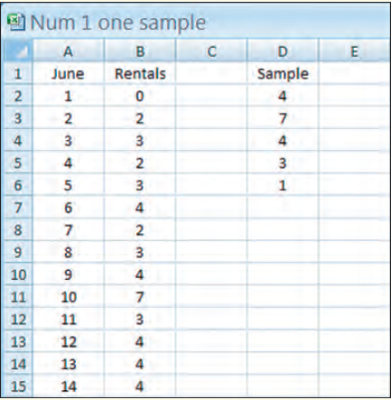
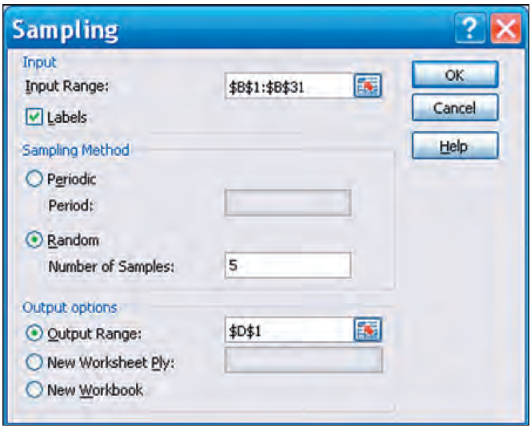
Simple Random Sample: Using software

Slide 15
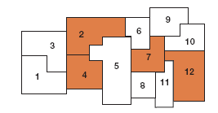
Other Types of Random Sampling
Systematic Random Sampling: The items or individuals of the population are arranged in some order. A random starting point is selected and then every kth member of the population is selected for the sample.
Stratified Random Sampling: A population is first divided into subgroups, called strata, and a sample is selected from each stratum. Useful when a population can be clearly divided in groups based on some characteristics.
Cluster Sampling: A population is divided into clusters using naturally occurring geographic or other boundaries. Then, clusters are randomly selected and a sample is collected by randomly selecting from each cluster.

Slide 16
Sampling Error
The sampling error is the difference between a sample statistic and its corresponding population parameter.
Sampling Error occurs when the sample is not representative of the population
Non-sampling Errors – all errors other than sampling errors
Missing Data, Recording, Data Entry, and Analysis Errors
Poorly conceived concepts , unclear definitions, and defective questionnaires
Response errors occur when people do not know, will not say, or overstate in their answers

Slide 17
Sampling Distribution of the Sample Mean
The sampling distribution of the sample mean is a probability distribution consisting of all possible sample means of a given sample size selected from a population.

Slide 18
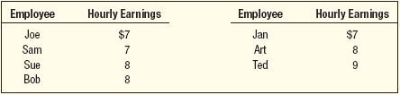
Sampling Distribution of the Sample Means – Example
A company has seven production employees (considered the population). The hourly earnings of each employee are given in the table below.
1. What is the population mean?
2. What is the sampling distribution of the sample mean for samples of size 2?
3. What is the mean of the sampling distribution?
4. What observations can be made about the population and the sampling distribution?

Slide 19
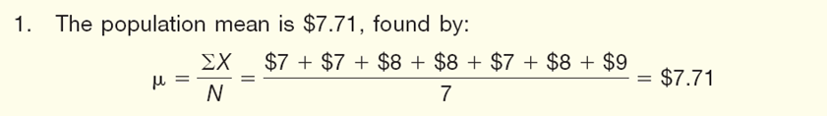
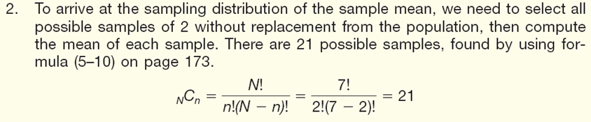

Sampling Distribution of the Sample Means – Example
8-19

Slide 20
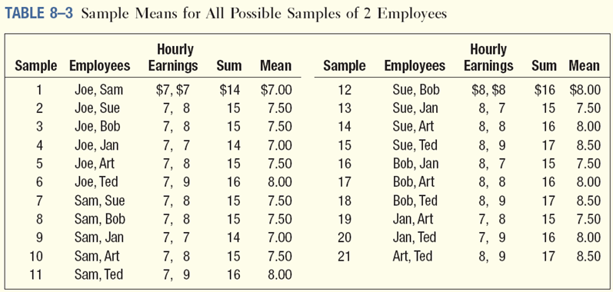
Sampling Distribution of the Sample Means – Example

Slide 21
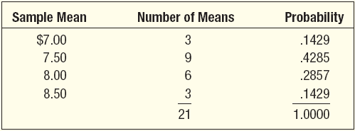
Sampling Distribution of the Sample Means – Example

Slide 22
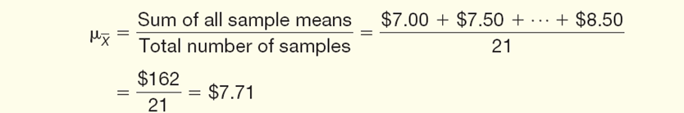
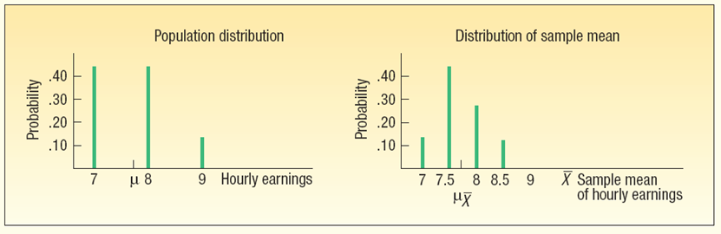
Sampling Distribution of the Sample Means – Example

Slide 23
Sampling Distribution of the Sample Means – Example
The mean of the distribution of the sample mean is equal to the mean of the population.
The spread in the distribution of the sample mean is less than the spread in the population values.
As the size of the sample is increased, the spread of the distribution of the sample mean becomes smaller.
The shape of the sampling distribution of the sample mean and the shape of the frequency distribution of the population values are different. The distribution of the sample mean tends to be more bell-shaped and to approximate the normal probability distribution.

Slide 24
Central Limit Theorem
Central limits theorem allows one to study populations with differently shaped distributions
Central limits theorem creates the potential for applying the normal distribution to many problems when sample size is sufficiently large
Advantage of Central Limits theorem is when sample data is drawn from populations not normally distributed or populations of unknown shape can also be analyzed because the sample means are normally distributed due to large sample sizes

Slide 25
Central Limit Theorem
CENTRAL LIMIT THEOREM If all samples of a particular size are selected from any population, the sampling distribution of the sample mean is approximately a normal distribution. This approximation improves with larger samples.
For any sample size, the sampling distribution of the sample mean will also be normal if the population follows a normal probability distribution.
If the population distribution is symmetrical (but not normal), the normal shape of the distribution of the sample mean emerges with samples as small as 10.
If a distribution is skewed or has thick tails, it may require samples of 30 or more to observe the normality feature.
The mean of the sampling distribution is equal to μ and the variance is equal to σ²/n.

Slide 26
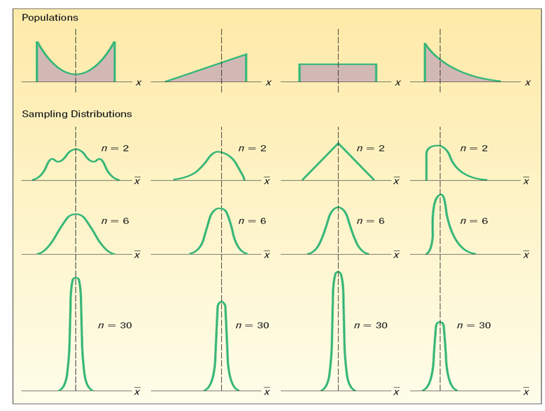
Sampling Methods and the Central Limit Theorem

Slide 27
Sampling, sampling Bias and the Central Limit Theorem

